Slide 1
The 68000 family

Slide 2
INTRODUCTION
Introduced by Motorola in 1979.
Used in Macintosh systems, gaming applications and embedded applications like laser printers.
68000 and its family are used in networking and telecom equipments, television set-top boxes, laboratory and medical instruments, and even handheld calculators.

Slide 3
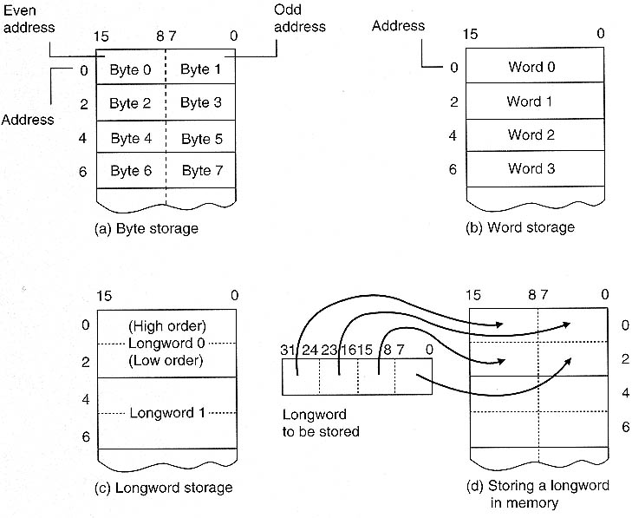
Memory Organization

Slide 4
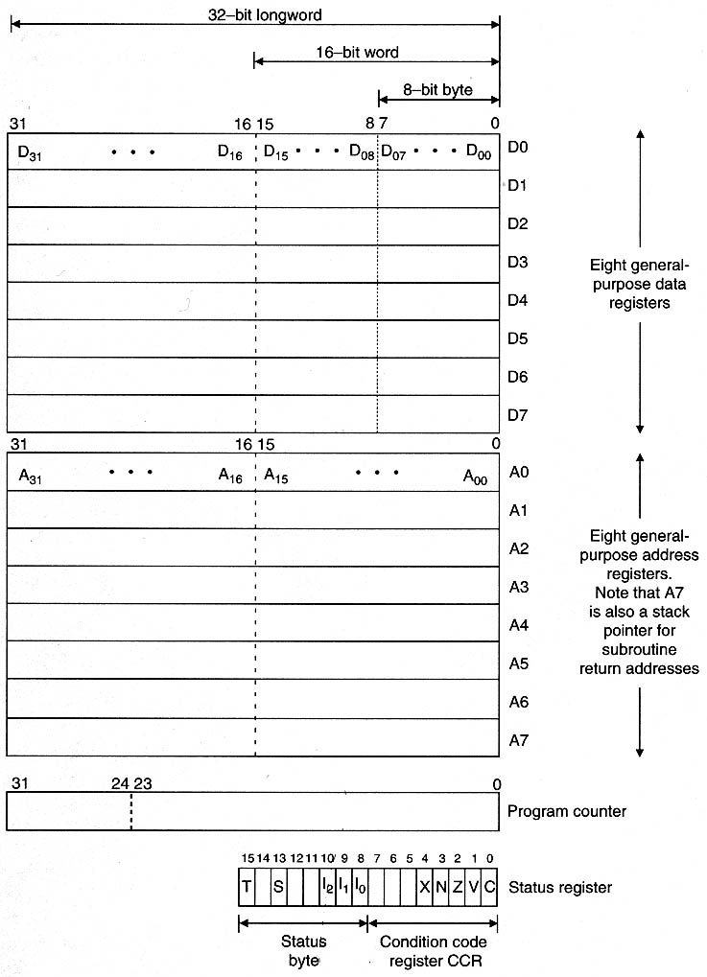
68000 architecture

Slide 5
Registers are divided into 3 groups
a)Data b)Address c)Special purpose
32 bit registers and can carry out 32-bit operations on data or address.
But 68000 is interfaced to external systems by a 16-bit data
bus,forcing all 32-bit accesses to be implemented as 2
consecutive accesses.
Addr bus is only 24-bits wide,hence A24-A31 has no effect.
(addr are written as 6 hex characters instead of 8)
8 general purpose data registers(D0-D7) .
- reg are general in the sense that any operation in Di is
permitted to Dj.
Ex:ADD.B D0,D1 (D1←D1+D0)

Slide 6
8 addr reg,A0-A7 and each reg is a pointer register.
Byte operations on bits 0 -7 of an addr reg is not permitted.
A7 is a special-purpose addr reg which acts as stack pointer.
68000 runs in 2 modes
a)Supervisor mode:OS runs in this mode.
b)User Mode:Pgms controlled by OS runs in this mode.
Each mode has its own A7 ,SSP and USP.
If a user corrupts his USP,the entire system will not crash as we will have a separate SSP for OS.
2 special purpose reg
a) Program Counter(PC) b)Status Register(SR)

Slide 7
Program Counter(PC):32 bits wide and contain the addr of the
next instrn to be executed.(only 24 bits useful)
-enables look-ahead.
Status Register(SR): divided into 2 logical fields
a)System Bytes: 8 MSB bits that controls operating mode.
5 bits:T,S,I₀,I₁ and I₂
Cant be modified by programmer running in user mode.
b)Condition Code Register:LSB which indicates outcome of
arithmetic and logical instrns.
Consider the operation ADD.B D0,D1 if [D0]=$12345678 ,
[D1]=$13579B57

Slide 8
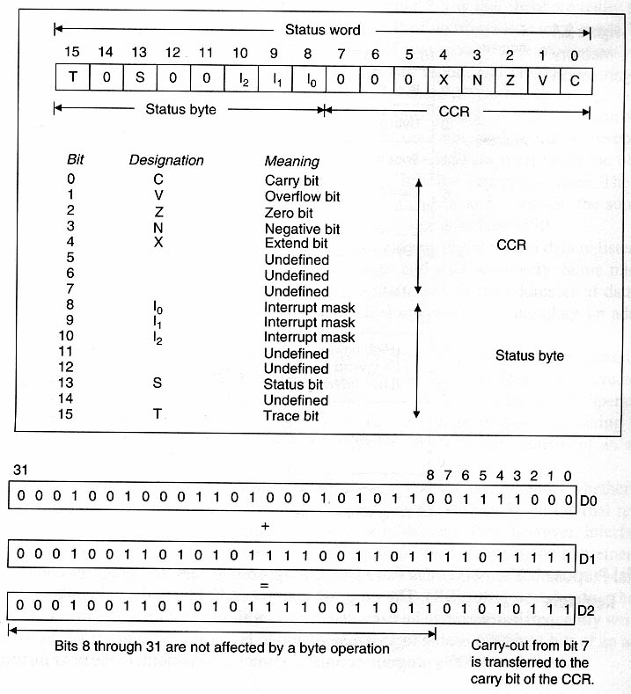
68000 Status Register

Slide 9
X-bit is identical to Carry bit and used only when a
byte/word/longword is extended beyond 8,16 or 32 bits.
During addition,subtraction,negation or shifting,X-bit reflects
the status of carry bit.
X bit is provided as C bit will be used as a multipurpose test
flag.(to transfer information between subroutines).
If C-bit is set following a return from subroutine,it denotes an
error occurred in sub-routine.
X bit is provided exclusively for arithmetic operations that
generates a true carry out.
Instrns like CMP,MOVE,AND,MUL,TST,CLR and DIV affect
the status of the carry bit but have no effect on X-bit

Slide 10
Addressing Modes

Slide 11
Register Transfer language(RTL)
Unambiguous notation to describe information manipulation
Registers are denoted by their names (eg. D0-D7, A0-A7)
Square brackets mean “the contents of”
Base number noted by a prefix (%-binary, $-hex)
Backward arrow indicates a transfer of information (←)
[D4] ← 50 Put 50 into register D4
[D4] ← $1234 Put $1234 into register D4
[D3] ← $FE 1234 Put $FE 1234 into register D3

Slide 12
1.Immediate Addressing
The operand will be part of the instruction.
Ex: MOVE.B #25,D2;move 25 to D2.
#→precedes the immediate operand and indicates to the assembler that the following value is to be used with the immediate addresing mode.
2.Absolute Addressing/Direct Addressing
Instrn contains the operand’s address.
Ex: MOVE.L D3,$1234 ; [M($1234)]←[D3(16:31)]
[M($1236)]←[D3(0:15)]
MOV.W $1234,D3; [D3(0:15)]←[M($1234)]

Slide 13
3.Register Direct Addressing
-src or dstn. Operands are internal registers.
Ex:MOVE.L D0,D3; [D3]←[D0]
MOVE.W D0,D3; [D3(0:15)]←[D0(0:15)]
4.Address Register Indirect Addressing
-Addr of an operand is in a register.
-reg. is called a pointer reg and is one of addr reg.
Ex: MOVE.L (A0),D3 ; [D3] ←[M([A0])]
5.Addr Reg Indirect with PostIncrement Addressing
-E.A is generated as in the reg indirect,except that contents of
addr. Reg is incremented by 1,2or4 after the execution of the
instrn.
Ex: MOVE.L (A0)+,D3 ; [D3]←[M(A0)]
[A0]←[A0]+ 4

Slide 14
6.Addr Reg Indirect with Predecrement Addressing
Specifed addr. reg. is decremented before the exe of instrn.
Ex:MOVE.L –(A0),D3 ; [A0]←[A0]-4
[D3]←[M([A0])]
7.Register Indirect with Displacement Addressing
E.A is calculated by adding the contents of addr reg to 16-bit displacement word forming part of instrn.
Ex: MOVE.L 12(A4),D3 ; [D3]←[M(12+[A4])]
8.Reg Indirect with Index Addressing
-E.A is sum of contents of addr reg,general reg and displacement.
Ex: MOVE.L 9(A1,D0.W),D3; [D3]←[M(9+[A1]+[D0(0:15)])]

Slide 15
9. Program counter Relative Addressing mode
Similar to register indirect addressing, except that the address of an operand is specified with respect to the contents of the PC rather than with respect to the contents of an address register.
→PC with displacement: EA=[PC]+d16
Ex: MOVE.B TABLE(PC),D2
------
------
TABLE DC.B value1
TABLE DC.B value2

